Slide 1
FSM Final Project
Done by: Arthur Butler
James Faber

Slide 2
Final State Machine
A mathematical model of computation is known as a finite-state machine (FSM), finite-state automaton, finite automaton, or simply a state machine. It is an abstract machine with a finite set of possible states at any given moment. As a result of some inputs, the FSM can transition from one state to another, which is referred to as a transition. A list of an FSM's states, its starting state, and the inputs that cause each transition are used to define it. Deterministic and non-deterministic finite-state machines are the two types of finite-state machines. Any non-deterministic finite-state machine can be converted into a deterministic equivalent.

Slide 3
What is A Sequential Circuit
The method of generating a logic diagram from the specification of the circuit's desired behavior is known as sequential circuit design. The behavior of a circuit is frequently described in language. Deriving a precise specification of the necessary behavior in terms of a state table or a state diagram is the next stage in the design process. Since there are no set principles that can be created to generate a state diagram or a state table, this is perhaps the most challenging stage in the design. The only guides are the designer's intuition and expertise. The subsequent processes become mechanical after the description is transformed into a state diagram or state table. Through the use of the examples in this Question, we will explore the traditional design process.

Slide 4
You’ve been enlisted to design a soda machine dispenser for the IT
department students' lounge. Sodas are partially subsidized by the student chapter of the
ACM, so they cost only 25 cents each. The machine accepts 5 cents, 10 cents, and shillings.
When enough coins have been inserted, it dispenses the soda and returns any
necessary change. Design an FSM controller for the soda machine. The FSM inputs
are 5 cent, 10 cent, and shilling, indicating which coin was inserted. Assume that
exactly ONE coin is inserted on each cycle. The outputs are Dispense, Return 5 Cents,
Return 10 Cents, and Return Two 10 Cents. When the FSM reaches 25 cents, it asserts
Dispense and the necessary Return outputs required to deliver the appropriate
change. Then it should be ready to start accepting coins for another soda.
Question

Slide 5
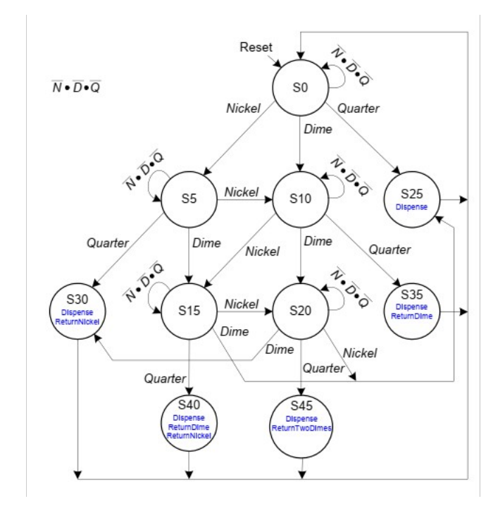
Old FSM Diagram

Slide 6
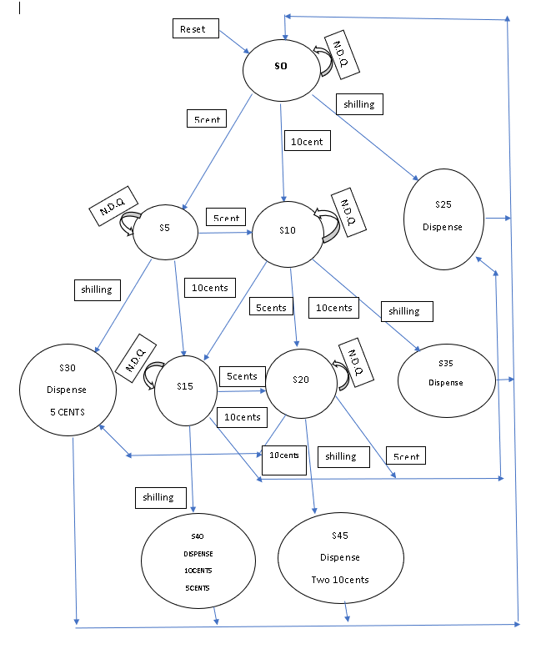
FSM UPDATED

Slide 7
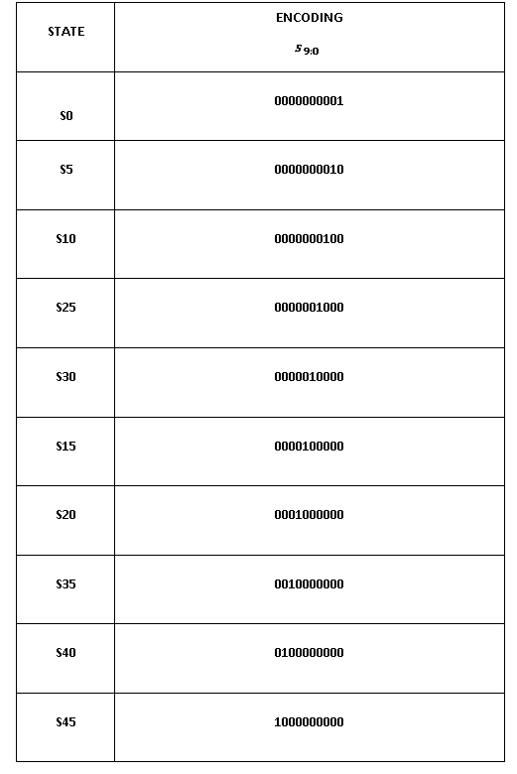
State Encoding Table

Slide 8
State Transition Table
Based on the current state and other inputs, a state-transition table displays the next state that a finite-state machine will enter. It functions fundamentally as a truth table, with the next state and other outputs as inputs and the present state and other inputs as outputs. One of the various ways to describe a finite-state machine is via a state-transition table. An additional method is a state diagram.

Slide 9
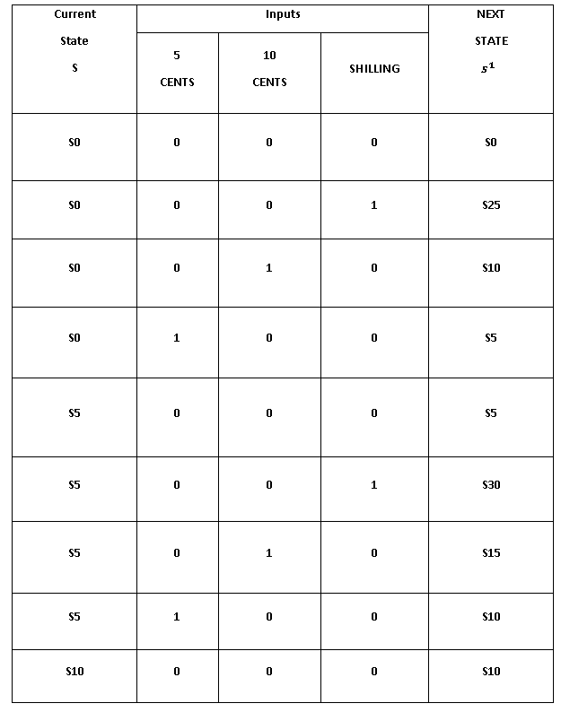
State Transition Table

Slide 10
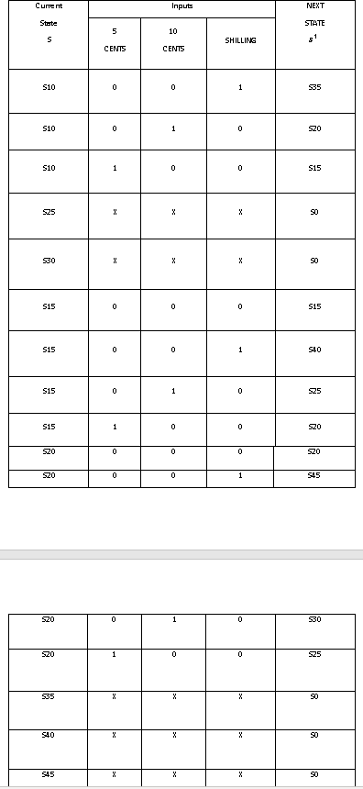
State Transition table Con’t

Slide 11
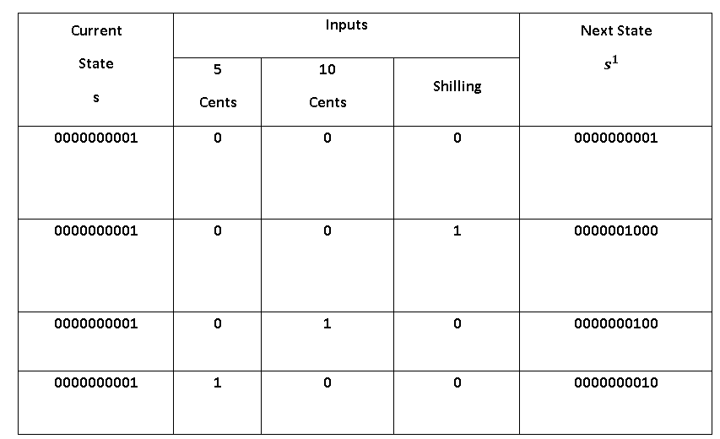
Output Table

Slide 12
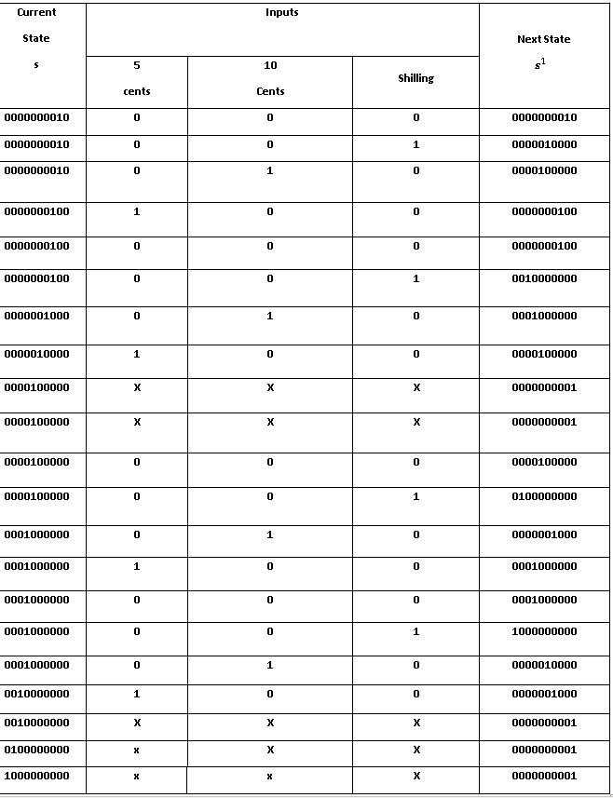
Output Table Results

Slide 13
Output table
State | Dispense | Return 10 cents | Return 5 cents | Return 2 10 cents
S25 | 1 | X | X | X
S35 | 1 | 1 | X | X
S45 | 1 | X | X | 1
S40 | 1 | 1 | 1 | X
S30 | 1 | X | 1 | X

Slide 14
Output table
Output
Dispense= 1110011000
Return 5 cent= 0100010000
Return 10 cents= 0110000000
Return 2 10 cents= 1000000000
State | Dispense | Return 10 cents | Return 5 cents | Return 2 10 cents
0000001000 | 1 | X | X | X
0010000000 | 1 | 1 | X | X
1000000000 | 1 | X | X | 1
0100000000 | 1 | 1 | 1 | X
0000010000 | 1 | X | 1 | X

Slide 15

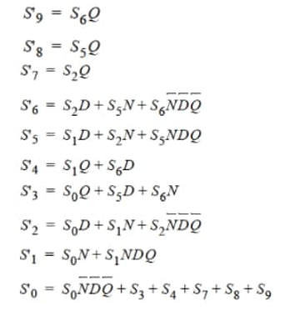



Simplified Equation
Dispense =
Return 5 cents =
Return 10 cents =
Return shilling =

Slide 16
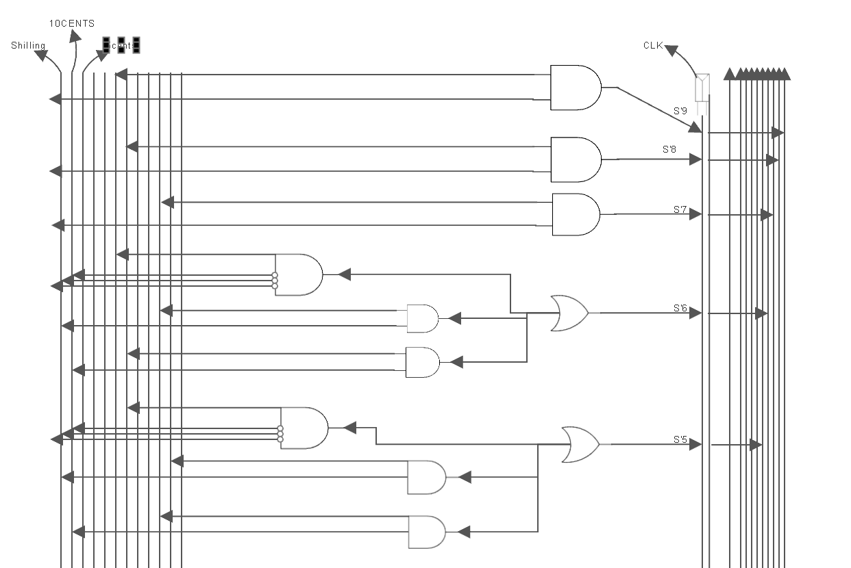
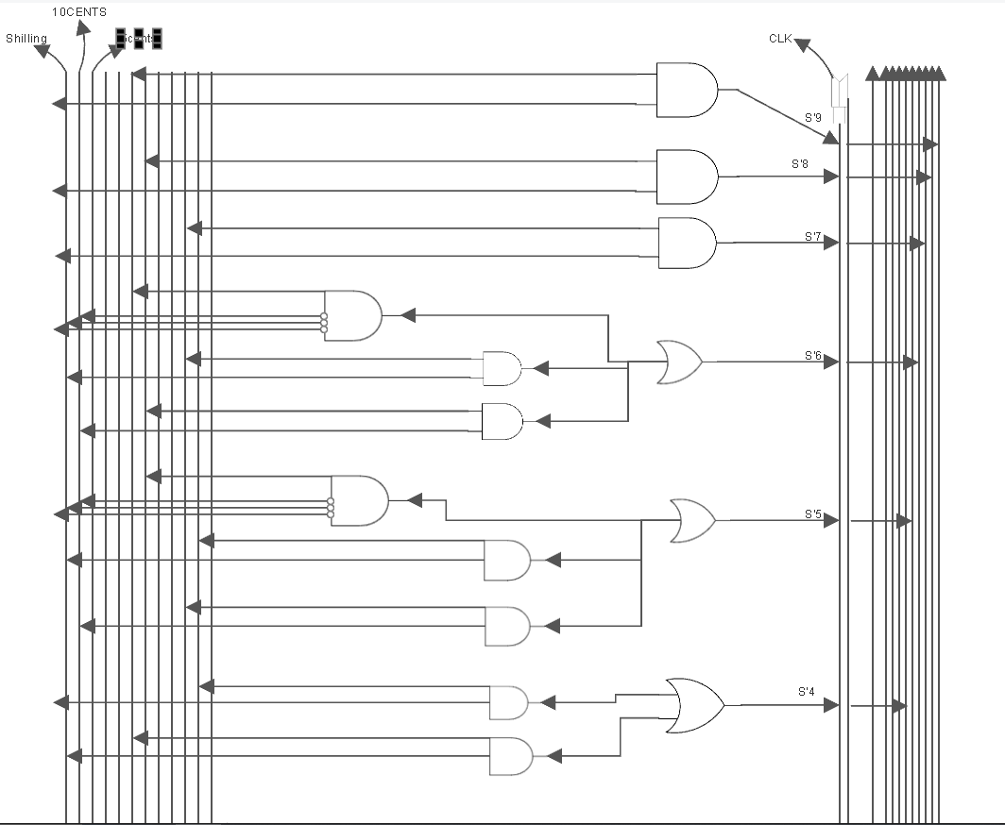
Circuit Diagram

Slide 17
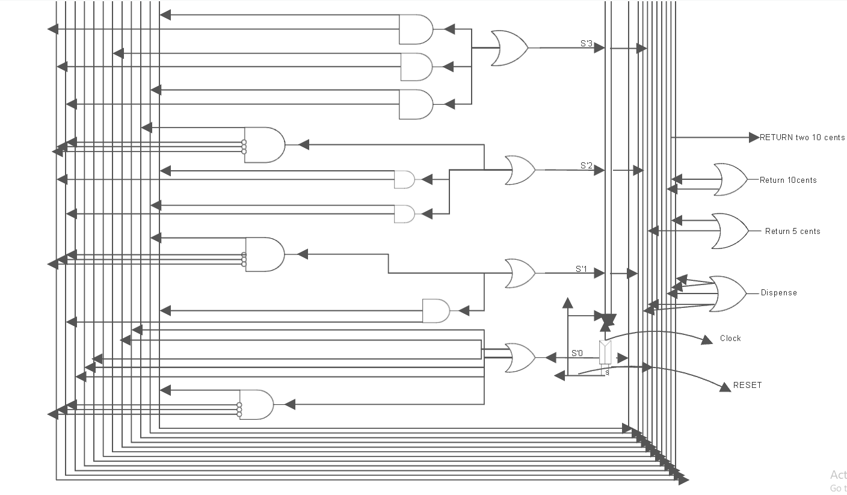
Circuit Diagram con’t

Slide 18
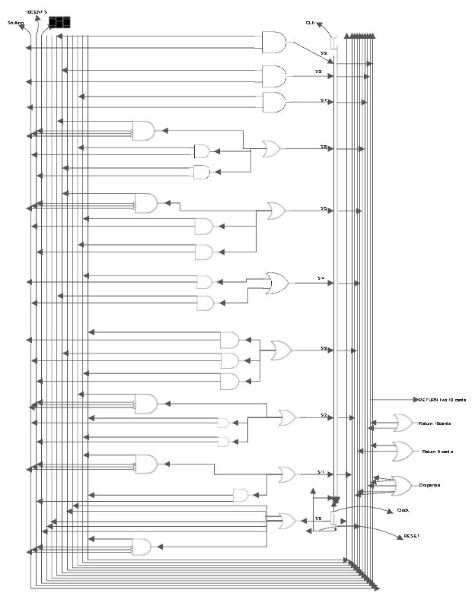
Circuit Diagram Full Picture

Slide 19
Link
Link for full complete diagram
https://cloud.smartdraw.com/share.aspx/?pubDocShare=D191484583AD641EC74781DAB4CB5B9E388
Done by: Arthur Butler
James Faber

